Slide 1

Probabilistic Biostatistics with
Jeff Mills, University of Cincinnati
Jeff Strawn, University of Cincinnati and
Cincinnati Children’s Hospital
Thanks to:
The JuliaCon organizers for the opportunity to present.
The Yung Family Foundation and Taft Research Foundation for research support.
and credit due to many other colleagues and coworkers.

Slide 2
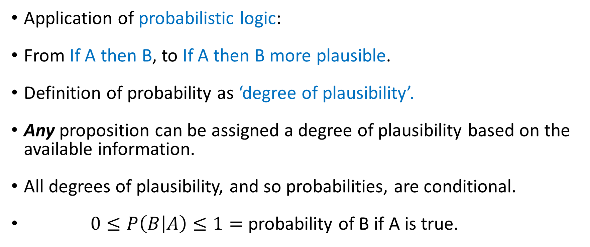
What is “probabilistic” statistics?
Application of probabilistic logic:
From If A then B, to If A then B more plausible.
Definition of probability as ‘degree of plausibility’.
Any proposition can be assigned a degree of plausibility based on the available information.
All degrees of plausibility, and so probabilities, are conditional.
$0≤P\left(B | A\right)≤1=$ probability of B if A is true.

Slide 3
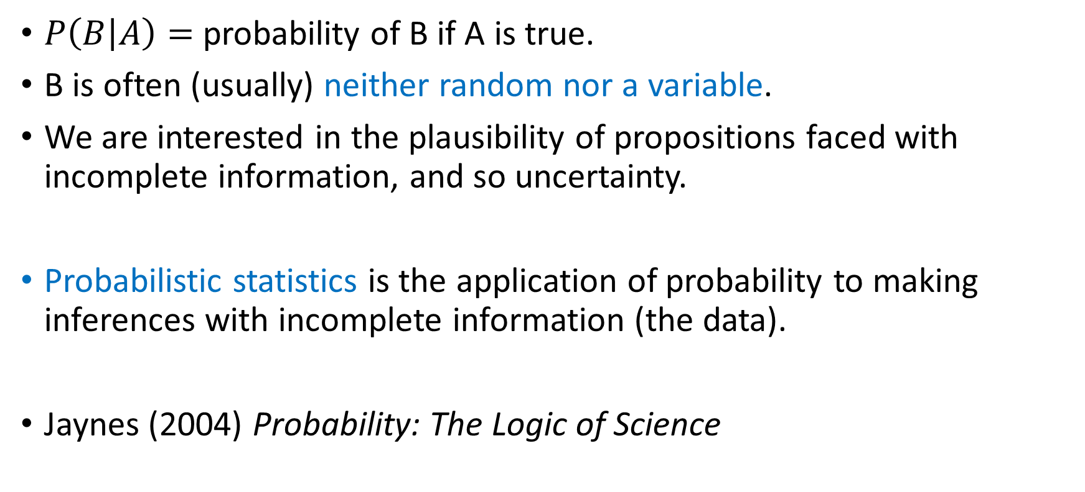
Probabilistic Logic $→$ Probabilistic Statistics
$P\left(B | A\right)=$ probability of B if A is true.
B is often (usually) neither random nor a variable.
We are interested in the plausibility of propositions faced with incomplete information, and so uncertainty.
Probabilistic statistics is the application of probability to making inferences with incomplete information (the data).
Jaynes (2004) Probability: The Logic of Science

Slide 4
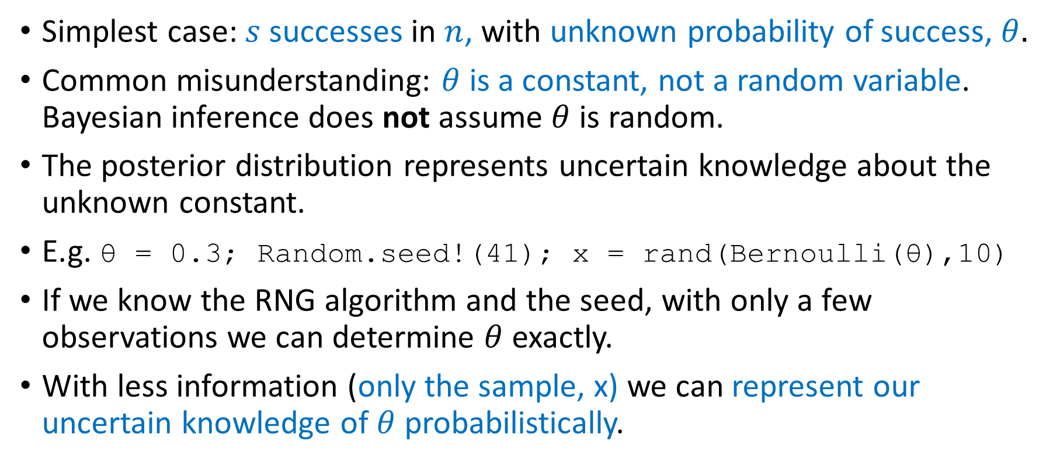
Probabilistic statistics
Simplest case: $s$ successes in $n$, with unknown probability of success, $θ.$
Common misunderstanding: $θ$ is a constant, not a random variable. Bayesian inference does not assume $θ$ is random.
The posterior distribution represents uncertain knowledge about the unknown constant.
E.g. θ = 0.3; Random.seed!(41); x = rand(Bernoulli(θ),10)
If we know the RNG algorithm and the seed, with only a few observations we can determine $θ$ exactly.
With less information (only the sample, x) we can represent our uncertain knowledge of $θ$ probabilistically.

Slide 5
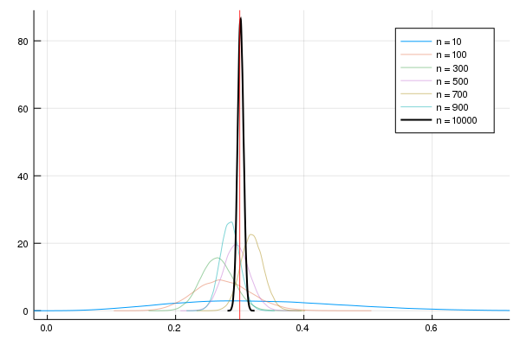
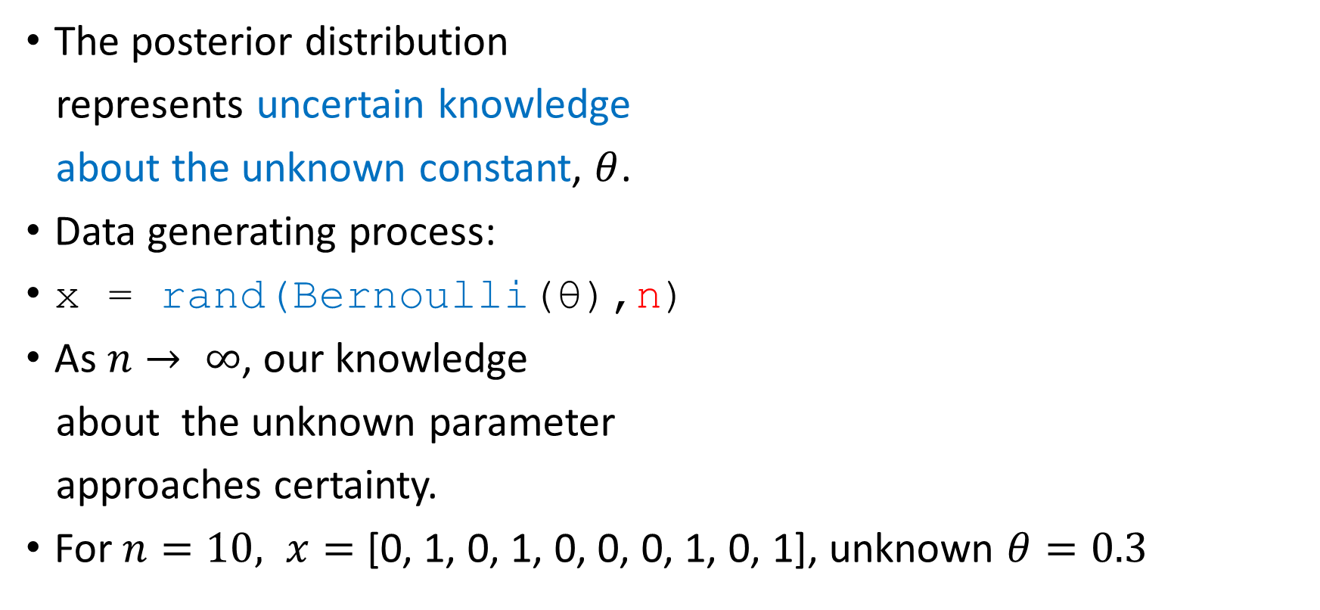

Uncertain knowledge about an unknown $≠$ the unknown is random
The posterior distribution
represents uncertain knowledge
about the unknown constant, $θ$.
Data generating process:
x = rand(Bernoulli(θ),n)
As $n→ ∞$, our knowledge
about the unknown parameter
approaches certainty.
For $n=10, x=$ [0, 1, 0, 1, 0, 0, 0, 1, 0, 1], unknown $θ=0.3$

Slide 6
Probabilistic Computation: A Fairy Tale
The axioms of probability lead directly to Bayes’ Theorem.
Bayes’ Theorem used as a rule for inference => analytical intractability as our problems become more complex.
Requires multi-dimensional integration => the curse of dimensionality is the main problem.
Stan Ulum, mathemagician, in hospital, couldn’t solve a complex combinatorial problem, so he invented the Monte Carlo method and solved the problem probabilistically.
He recovered, went back to Los Alamos and ran MC simulations on the computer (ENIAC).
=> MC simulation and Metropolis methods (1940s, 50s)

Slide 7
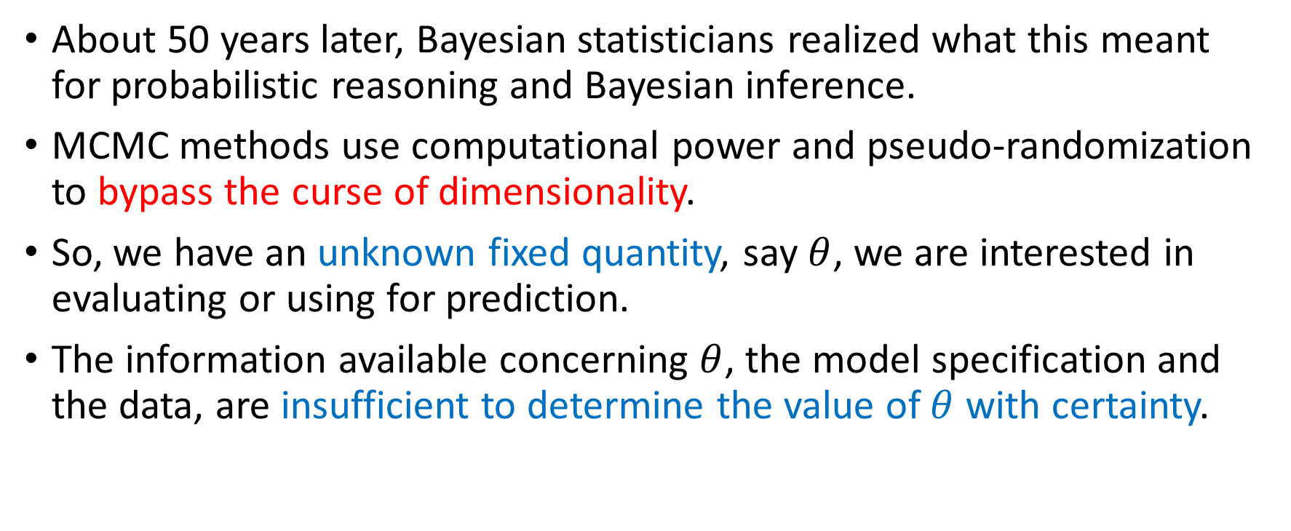
Probabilistic Computation: solving complex problems with uncertain answers numerically
About 50 years later, Bayesian statisticians realized what this meant for probabilistic reasoning and Bayesian inference.
MCMC methods use computational power and pseudo-randomization to bypass the curse of dimensionality.
So, we have an unknown fixed quantity, say $θ$, we are interested in evaluating or using for prediction.
The information available concerning $θ$, the model specification and the data, are insufficient to determine the value of $θ$ with certainty.

Slide 8
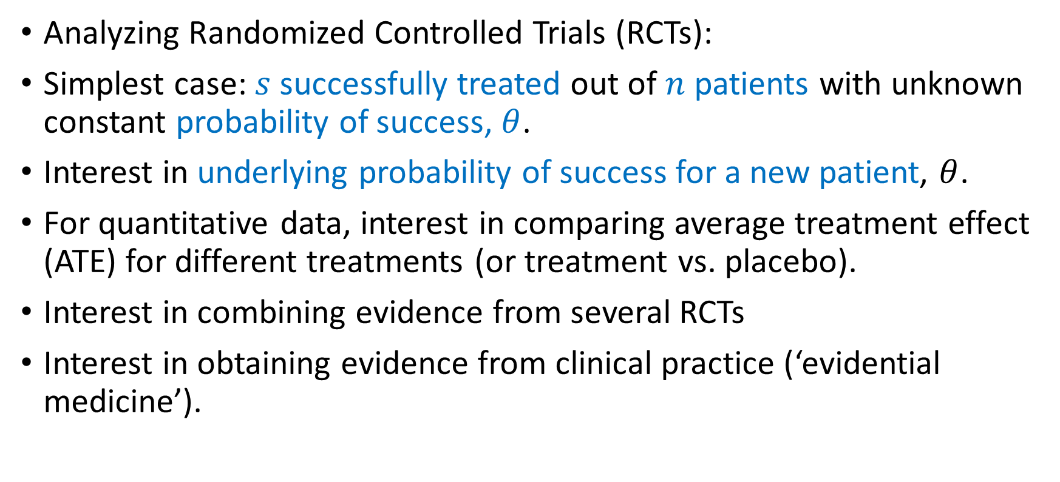
Probabilistic Biostatistics
Analyzing Randomized Controlled Trials (RCTs):
Simplest case: $s$ successfully treated out of $n$ patients with unknown constant probability of success, $θ$.
Interest in underlying probability of success for a new patient, $θ$.
For quantitative data, interest in comparing average treatment effect (ATE) for different treatments (or treatment vs. placebo).
Interest in combining evidence from several RCTs
Interest in obtaining evidence from clinical practice (‘evidential medicine’).

Slide 9


The two (or more) field (or hat) problem
Problem: We often must wear multiple expertise ‘hats’ when conducting scientific research. Research teams are expensive, so often the nonexpert has to gain some expertise.
Solution: Julia + computational probabilistic inference

Slide 10

MCMC + = (Keeping It Sophisticatedly Simple)
The “Bayesian machinery” of Markov chain Monte Carlo (MCMC) methods together with Julia offer a solution to this “two-field problem”.
They enable exact small sample inference and hypothesis testing for complex models without requiring the restrictive assumptions necessary to obtain analytical tractability (performance).
They facilitate the analysis of complex models with basic statistical concepts: frequency distributions, density plots, means, medians, modes, standard deviations, quantiles, and posterior odds (user friendliness).

Slide 11

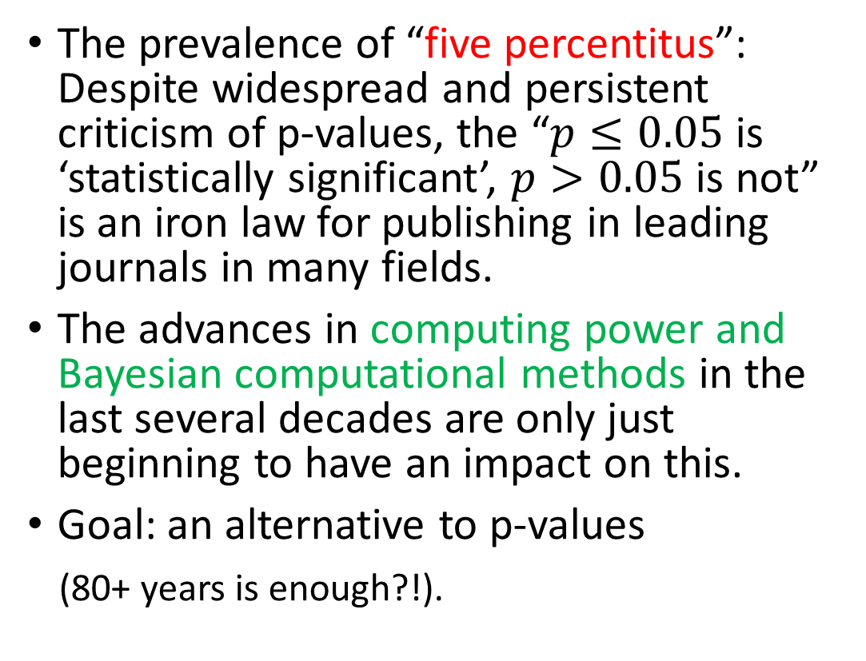
Overthrowing the dictatorship of p-values
The prevalence of “five percentitus”: Despite widespread and persistent criticism of p-values, the “$p≤0.05$ is ‘statistically significant’, $p>0.05$ is not” is an iron law for publishing in leading journals in many fields.
The advances in computing power and Bayesian computational methods in the last several decades are only just beginning to have an impact on this.
Goal: an alternative to p-values
(80+ years is enough?!).

Slide 12
Overcoming institutional inertia and bias
Strong institutional inertia and bias towards precise testing and use of p-values as `proper’ applied science (same methods 50+ years on!).
At the very least, we need a bridge from `pure’ hypothesis testing to Bayesian inference.
Problem: Strong institutional bias/inertia of 5% = `significant’.
Solution: Provide posterior odds as well as posterior tail probabilities (`Bayesian p-values’) and HPDIs.
Caveat: “A picture paints a thousand statistics” - Visualization often provides more valuable evidence than a test.
(See last year’s presentation and Bayestesting.jl on github)

Slide 13
Applications of Probabilistic Biostatistics with Julia
RCTs are high cost (e.g., medication expense, time required, and potential exposure of patients to ineffective treatments)
=> greater enthusiasm for improving statistical methods:
(1) for RCTs
2) for ‘naturalistically-collected’ clinical data to inform clinical practice without the need for RCTs.
Goal: Use and provide statistical tools to clinician-researchers that are intuitive and easy to use, yet sophisticated and powerful enough “under the hood” to answer complex questions.

Slide 14
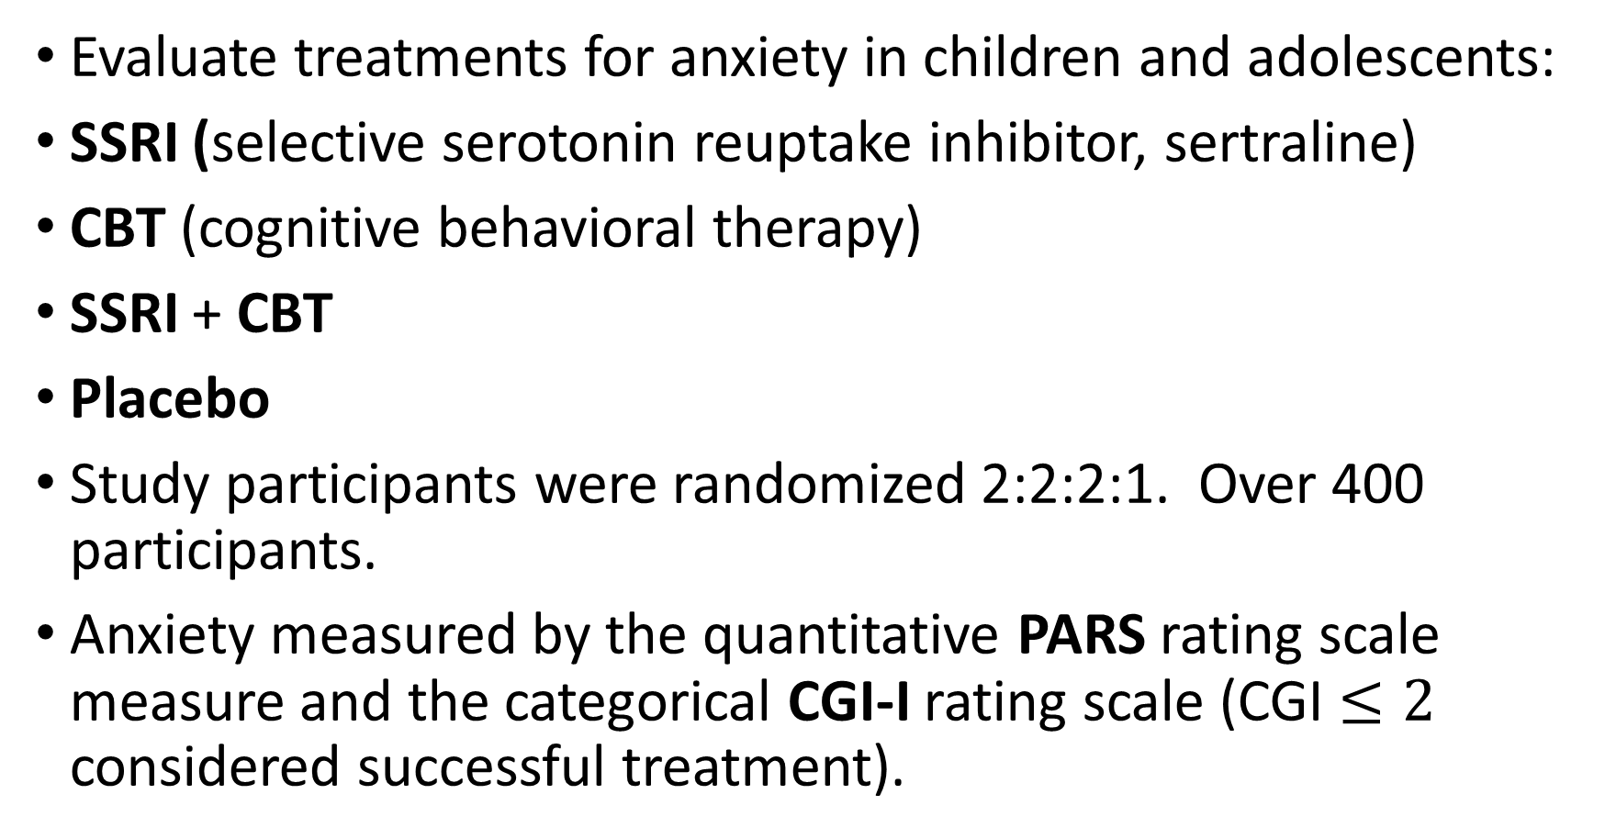
CAMS: Child/Adolescent Multimodal Study
Evaluate treatments for anxiety in children and adolescents:
SSRI (selective serotonin reuptake inhibitor, sertraline)
CBT (cognitive behavioral therapy)
SSRI + CBT
Placebo
Study participants were randomized 2:2:2:1. Over 400 participants.
Anxiety measured by the quantitative PARS rating scale measure and the categorical CGI-I rating scale (CGI $≤2$ considered successful treatment).

Slide 15
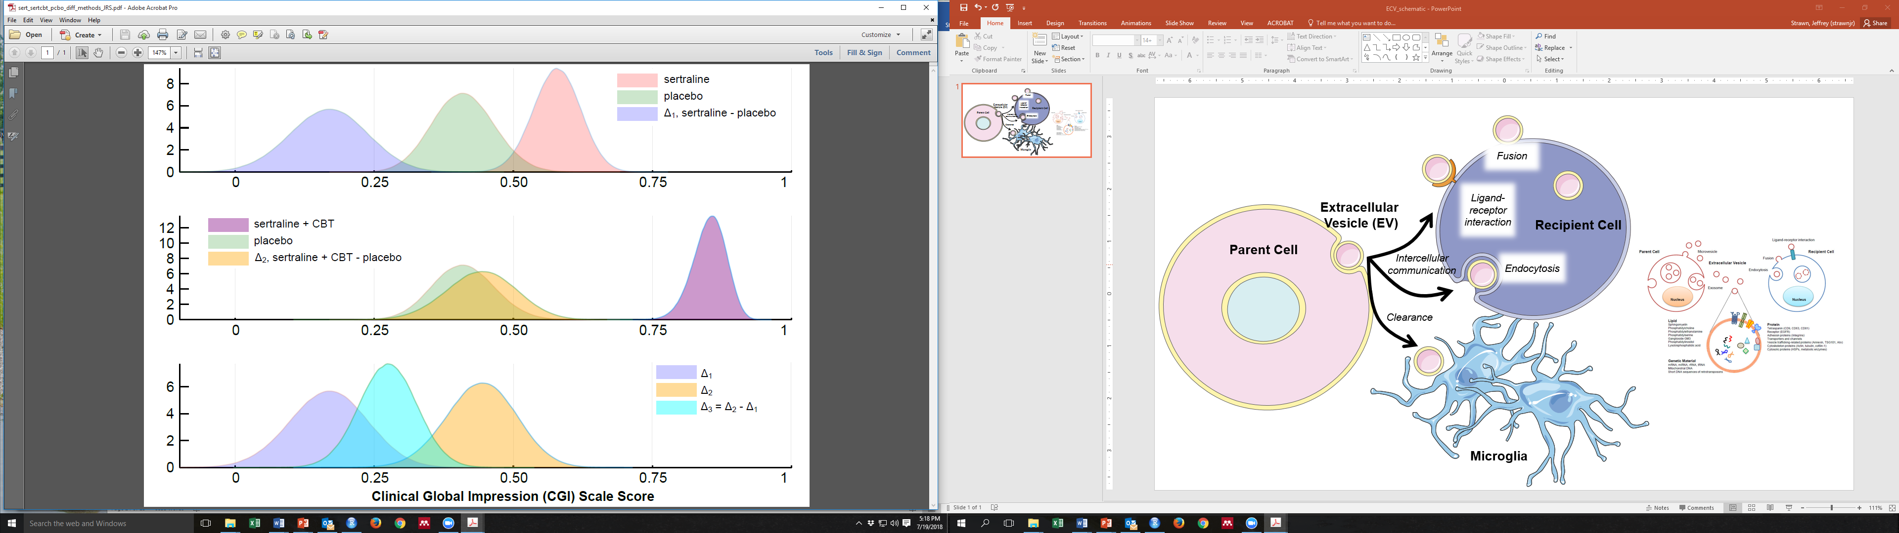
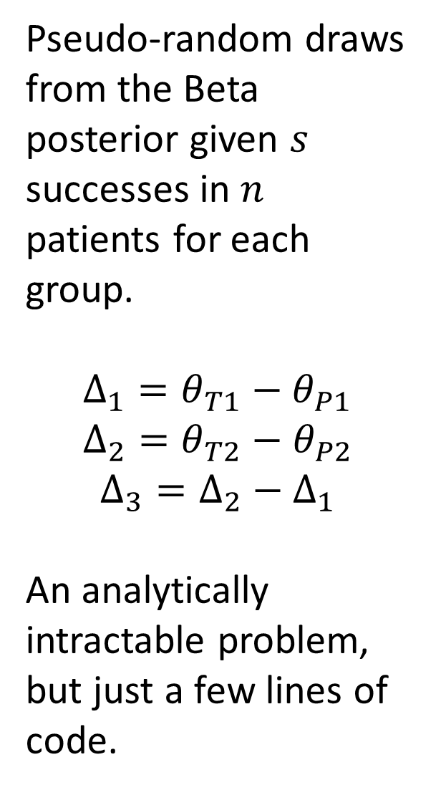
Pseudo-random draws from the Beta posterior given $s$ successes in $n$ patients for each group.
$$Δ_{1}=θ_{T1}−θ_{P1}$$
$$Δ_{2}=θ_{T2}−θ_{P2}$$
$$Δ_{3}=Δ_{2}−Δ_{1}$$
An analytically intractable problem, but just a few lines of code.

Slide 16
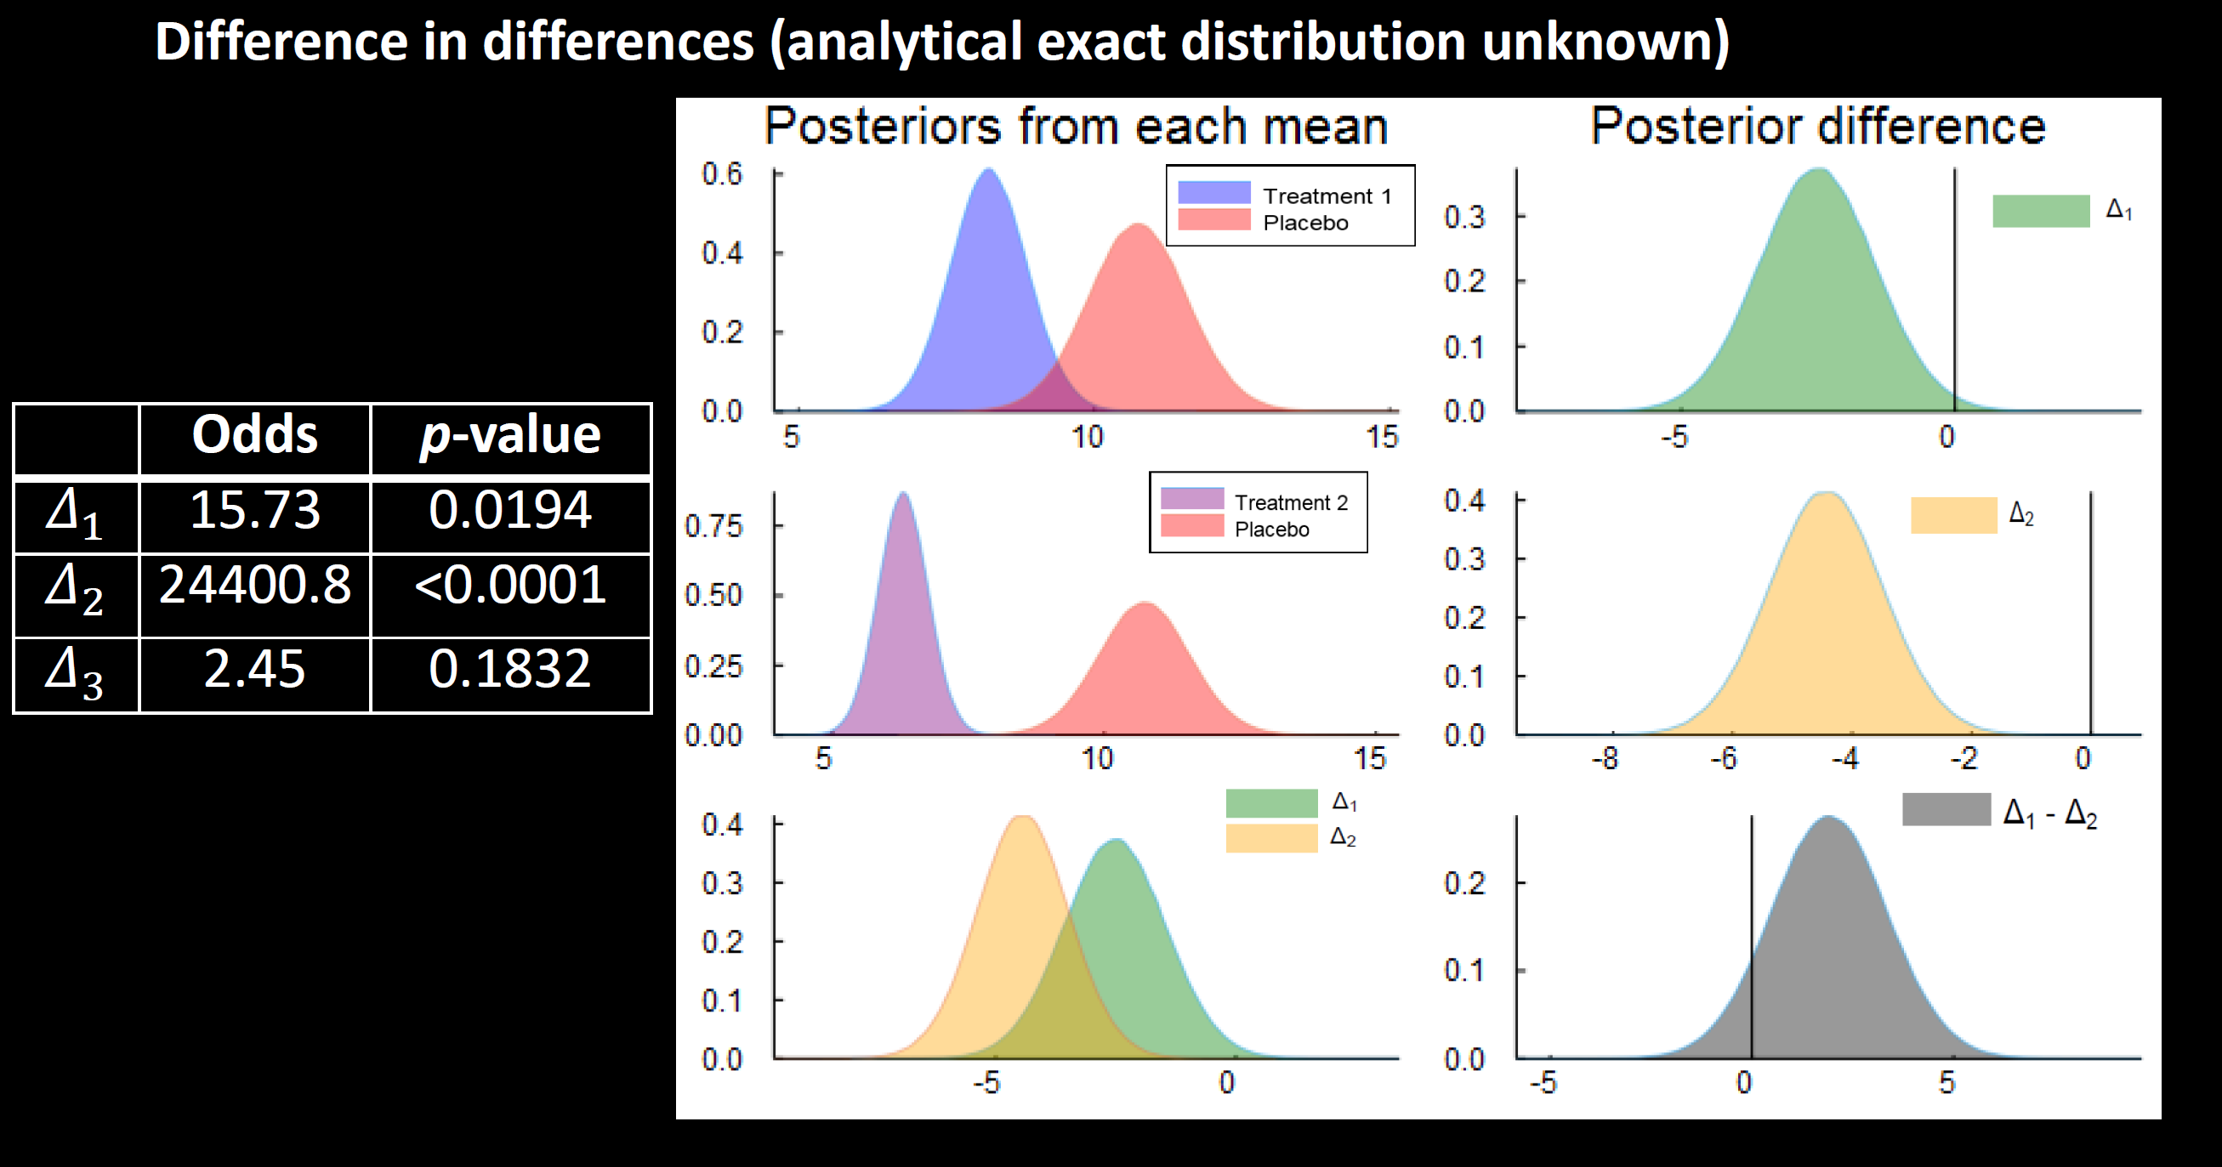

Slide 17
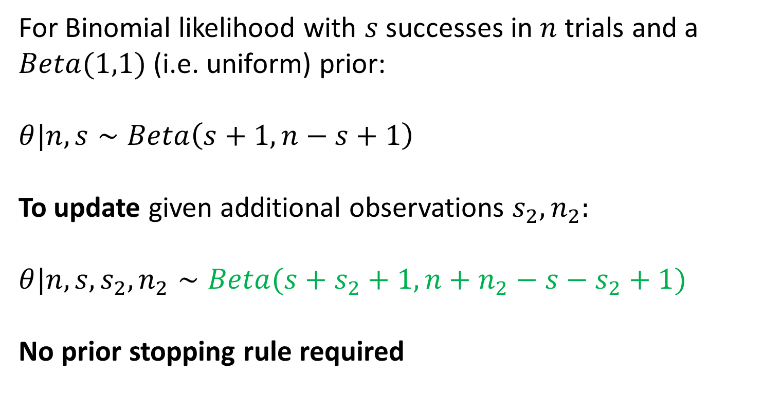
Sequential Bayesian updating
For Binomial likelihood with $s$ successes in $n$ trials and a $Beta(1,1)$(i.e. uniform) prior:
$$θ|n,s∼Beta\left(s+1,n−s+1\right)$$
To update given additional observations $s_{2}, n_{2}:$
$$θ|n,s,s_{2},n_{2}∼Beta(s+s_{2}+1,n+n_{2}−s−s_{2}+1)$$
No prior stopping rule required

Slide 18
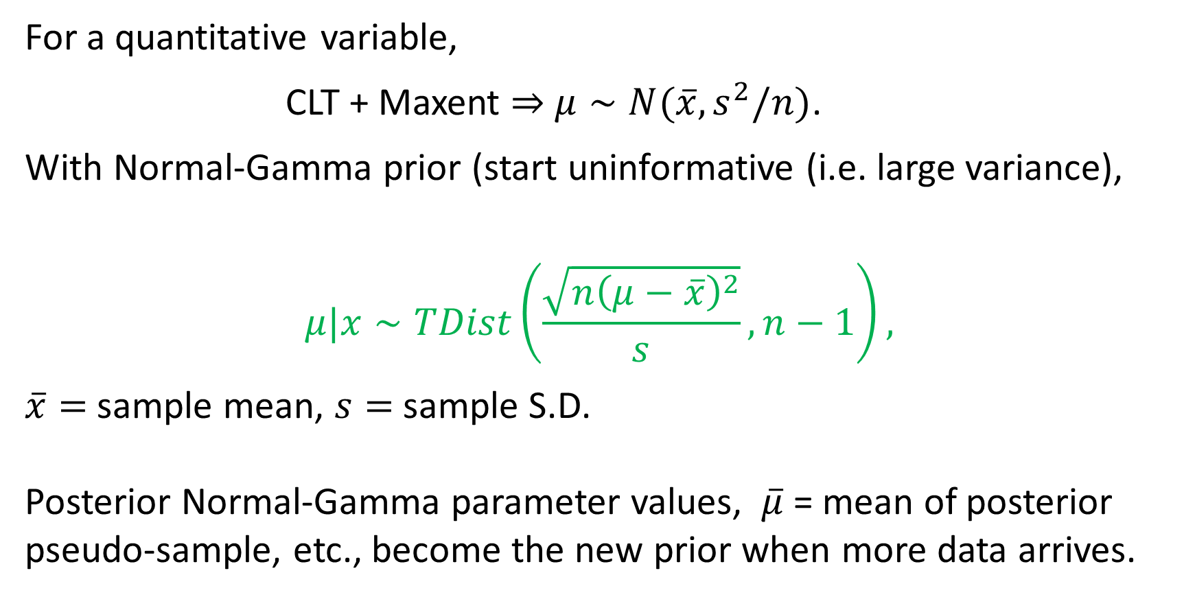
Sequential Bayesian updating
For a quantitative variable,
CLT + Maxent $⇒$ $μ∼N(\overline{x},s^{2}/n)$.
With Normal-Gamma prior (start uninformative (i.e. large variance),
$$μ|x∼TDist\left(\frac{\sqrt{n{\left(μ−\overline{x}\right)}^{2}}}{s},n−1\right),$$
$\overline{x}=$sample mean, $s=$sample S.D.
Posterior Normal-Gamma parameter values, $\overline{μ}$ = mean of posterior pseudo-sample, etc., become the new prior when more data arrives.

Slide 19
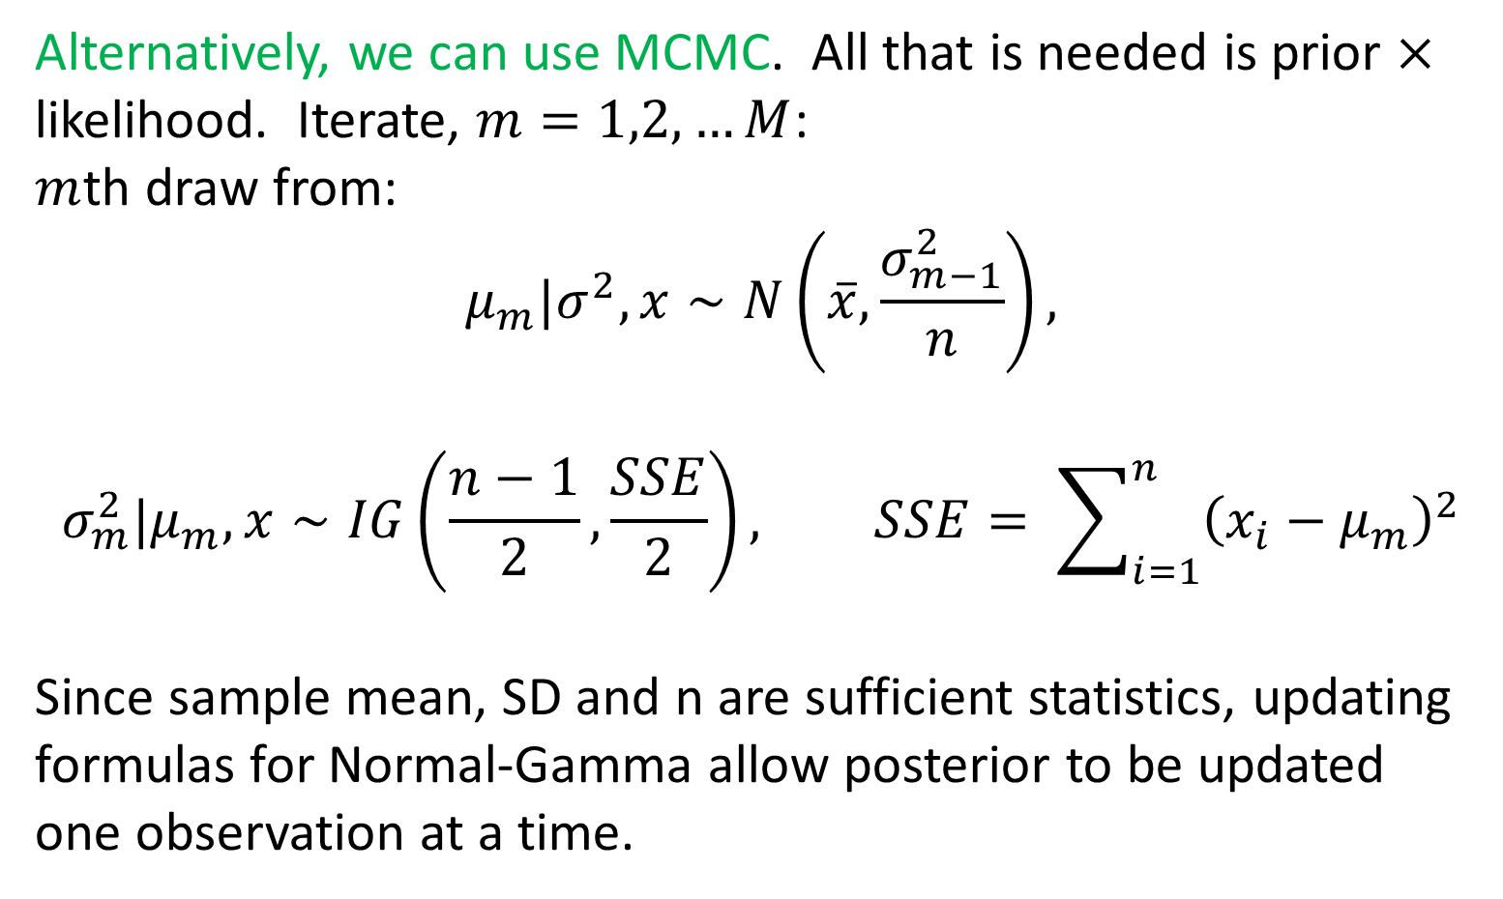
Sequential Bayesian updating
Alternatively, we can use MCMC. All that is needed is prior $×$ likelihood. Iterate, $m=1,2,…M$:
$m$th draw from:
$$μ_{m}|σ^{2},x∼N\left(\overline{x},\frac{σ_{m−1}^{2}}{n}\right),$$
$$σ_{m}^{2}|μ_{m},x∼IG\left(\frac{n−1}{2},\frac{SSE}{2}\right), SSE= \sum_{i=1}^{n}{{\left(x_{i}−μ_{m}\right)}^{2}}$$
Since sample mean, SD and n are sufficient statistics, updating formulas for Normal-Gamma allow posterior to be updated one observation at a time.

Slide 20
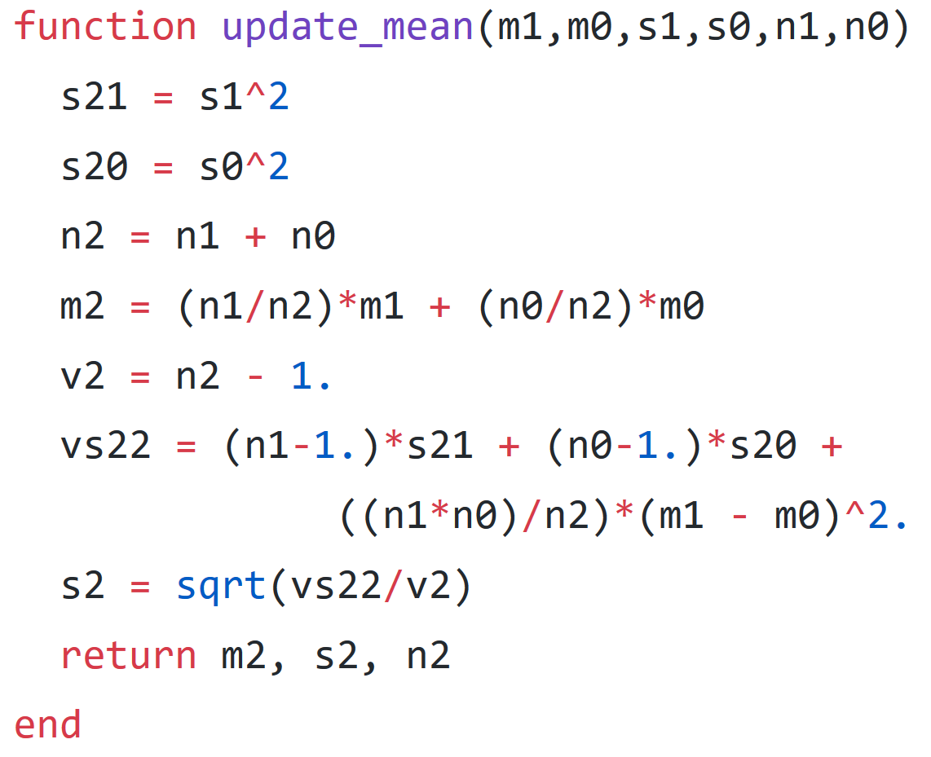
Bayesian updating without the math
The update-mean function in
BayesTesting.jl:
Can be used repeatedly.
We know the posterior is a
Student-t and m2, s2, n2
are sufficient statistics

Slide 21
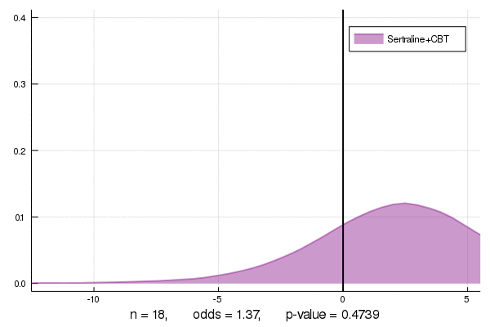
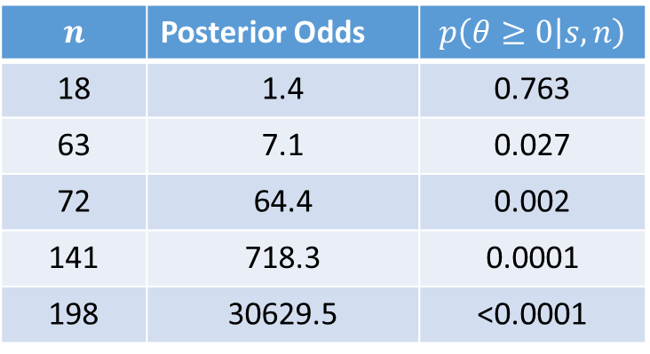
Sequential updating for CAMS data: when to stop?
Sertraline+CBT – Placebo
Updating the posterior density as data become available
(every 6 obs., 4 treatment, 2 placebo).
PDR = posterior odds against 0
$$n$$ | Posterior Odds | $$p\left(θ≥0 | s,n\right)$$
18 | 1.4 | 0.763
63 | 7.1 | 0.027
72 | 64.4 | 0.002
141 | 718.3 | 0.0001
198 | 30629.5 | <0.0001
Difference in ATE for PARS

Slide 22
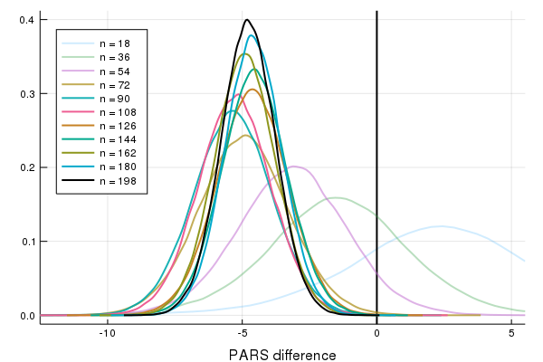
PARS for Difference in ATE (Sertraline+CBT – Placebo)

Slide 23
Bayesian Meta-analyses: the BHM
Bayesian Hierarchical Models (BHM) have a number of advantages when conducting a meta-analysis.
To combine the evidence from several different studies (results from different RCTs). Only summary statistics may be available.
Bayesian updating (w/o hierarchical priors) gives all data equal weighting, assuming the trials are homogeneous.

Slide 24
BHMs explicitly model across trial heterogeneity
By specifying a hierarchy of prior distributions, we can allow for variations in trial outcomes due to unobserved differences in trial conduct:
Different types of patients, different investigators, different locations and number of locations used, different treatments, dosing, trial length, etc.
The BHM allows estimation of the average outcomes from each individual trial and the average outcome across all trials, and also estimates the degree of heterogeneity.

Slide 25
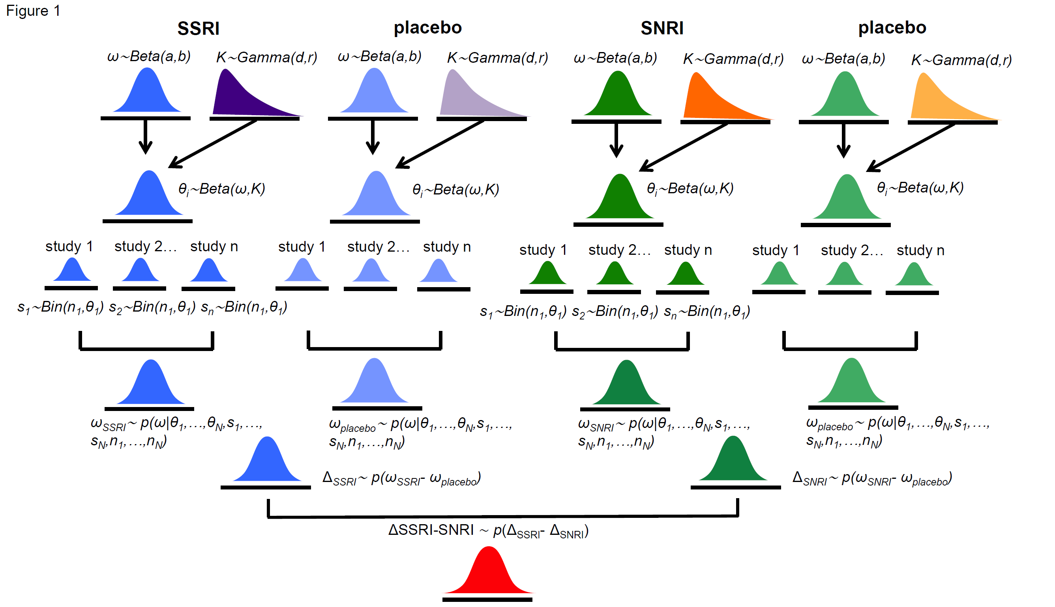
A Bayesian Hierarchical Model (BHM)

Slide 26
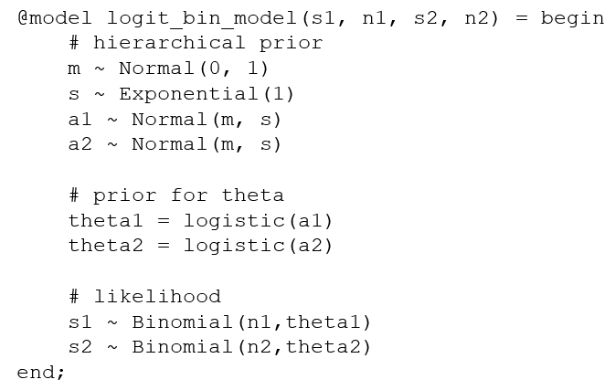
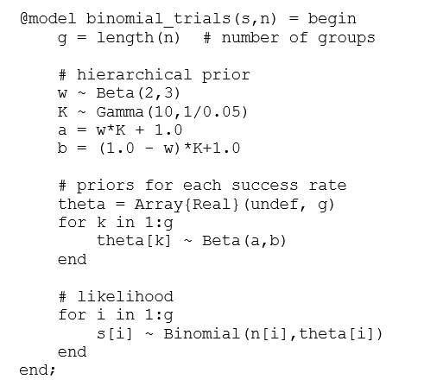
Turing.jl: Two specifications for models with a binomial (or Bernoulli) likelihood

Slide 27
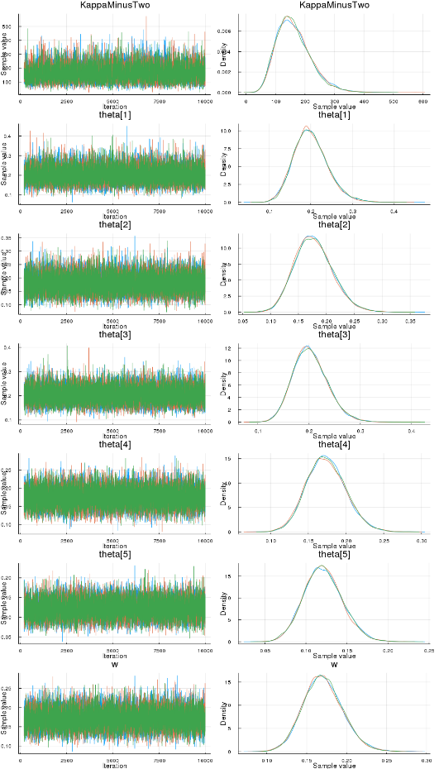
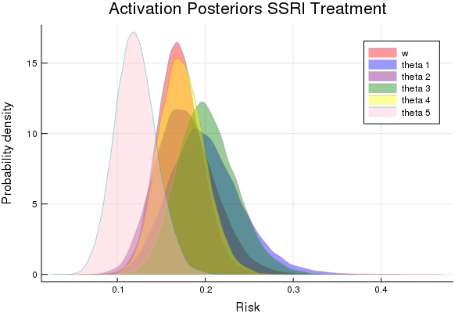
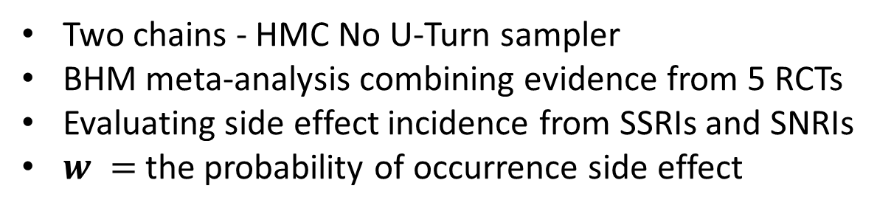
Turing.jl HMC estimation
Two chains - HMC No U-Turn sampler
BHM meta-analysis combining evidence from 5 RCTs
Evaluating side effect incidence from SSRIs and SNRIs
$w =$the probability of occurrence side effect

Slide 28
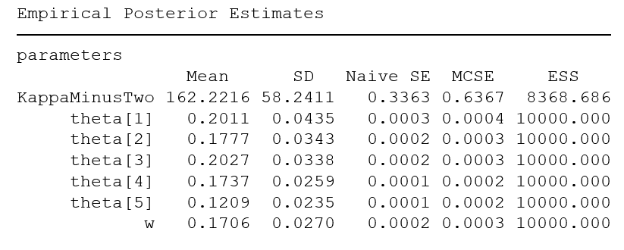
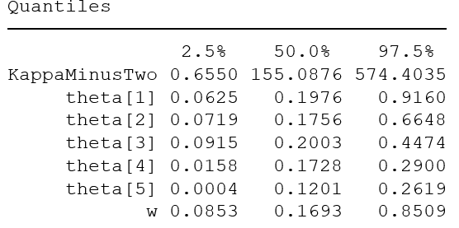
[NUTS] time = 33.1 seconds; 3 chains; samples per chain = 10,000 Parameters: w, theta[1:5], KappaMinusTwo (K-2)

Slide 29
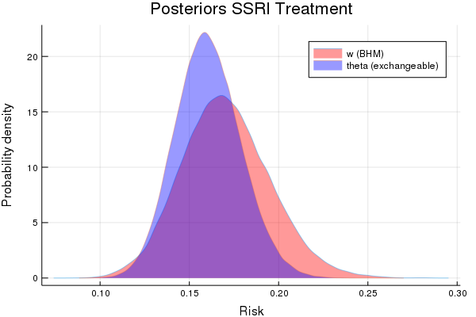
Meta-analysis for Activation Side Effect (AE)
BHM allows for heterogeneity across studies
Bayesian updating assumes homogeneity across studies

Slide 30
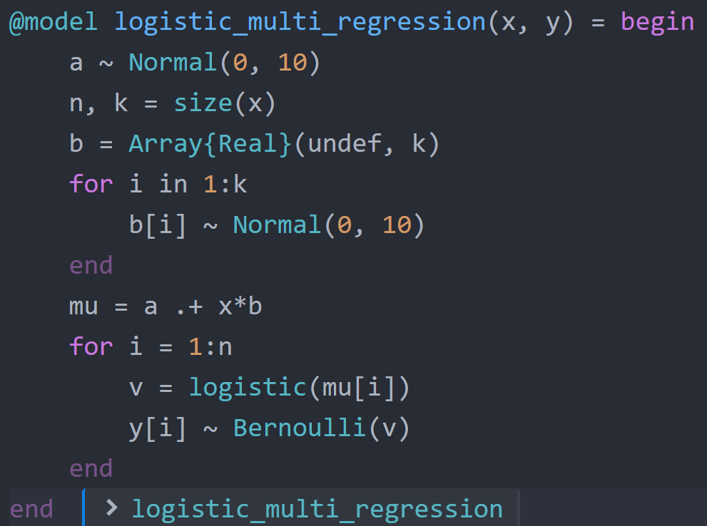
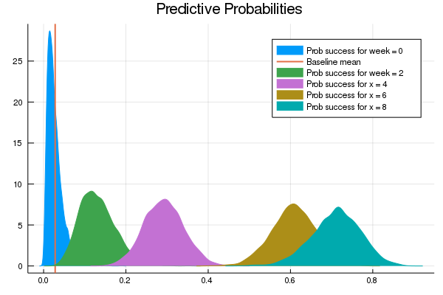
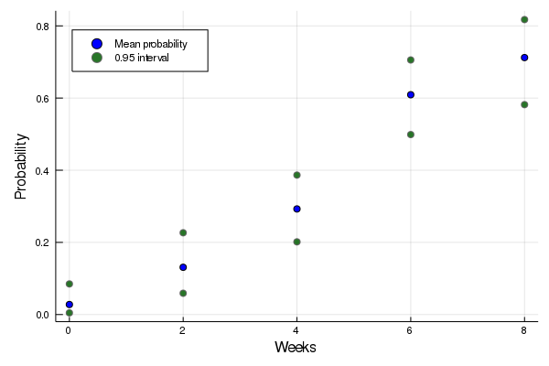
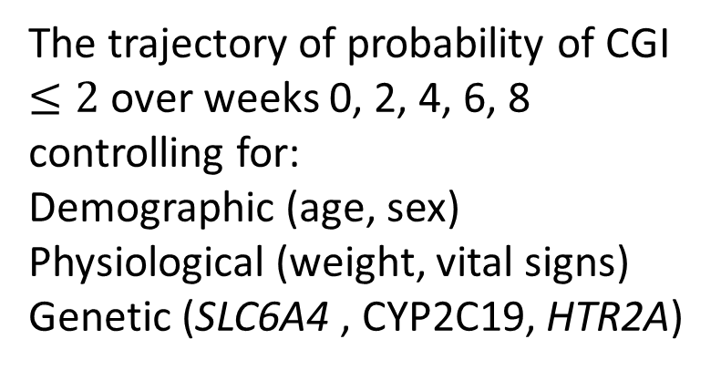
The trajectory of probability of CGI $≤2$ over weeks 0, 2, 4, 6, 8 controlling for:
Demographic (age, sex)
Physiological (weight, vital signs)
Genetic (SLC6A4 , CYP2C19, HTR2A)

Slide 31

Key Advantage of Julia:
Conservation of time and energy of the applied researcher (anyone who is not a computer scientist). For a computer scientist or programmer, the code is often the ultimate goal.
For an applied researcher, the code is just a means to an end.

Slide 32
Examples using Julia from our research
Reevaluating the evidence from previously conducted RCTs using Bayesian updating.
Analysis of abandoned trials – Bayesian posteriors from summary statistics.
Joint evaluation of tolerability and efficacy in RCTs – examine the joint posterior distribution.
Bayesian hierarchical modeling for meta-analyses, e.g. evaluating adverse events (“side effects”) in trial participants.

Slide 33
Thanks!
Code to generate the figures and results is available in the github repositories:
https://github.com/tszanalytics/Juliacon2019
https://github.com/tszanalytics/BayesTesting.jl

